Slide 1

Realized by:
Alejandra Cárdenas
Janete Barbosa

Slide 2
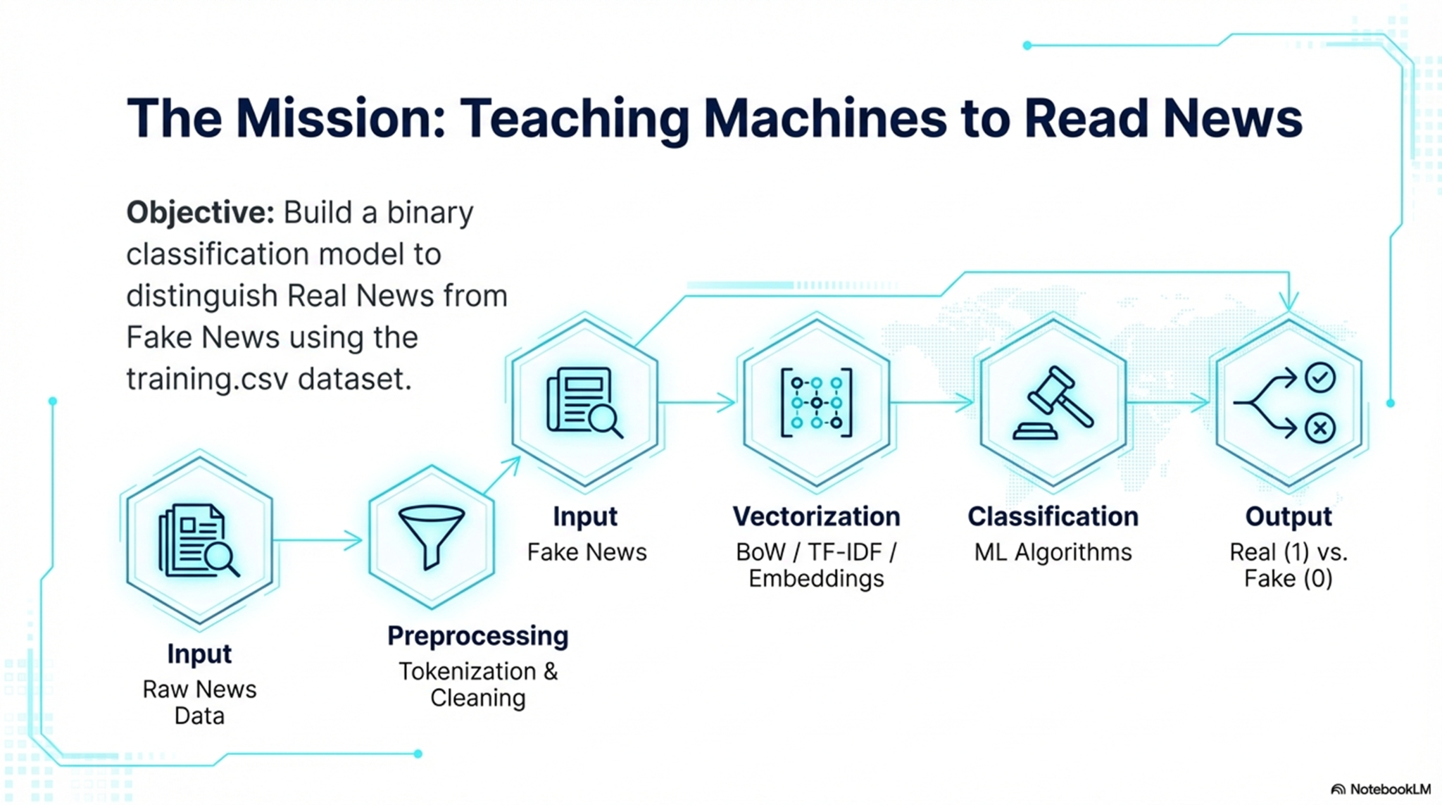
Cleaning
Stop Words
POS taggin
Lemmatization

Slide 3
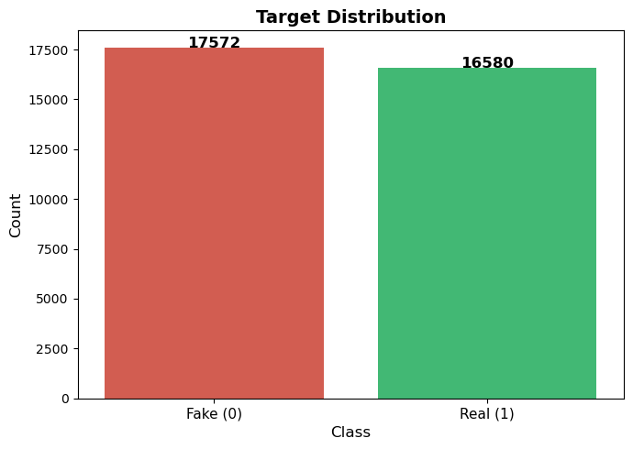
Data Overview
Shape: 34.152, 2
No missing values
Duplicated rows: 1946
Target:
Fake = 0
Real = 1

Slide 4
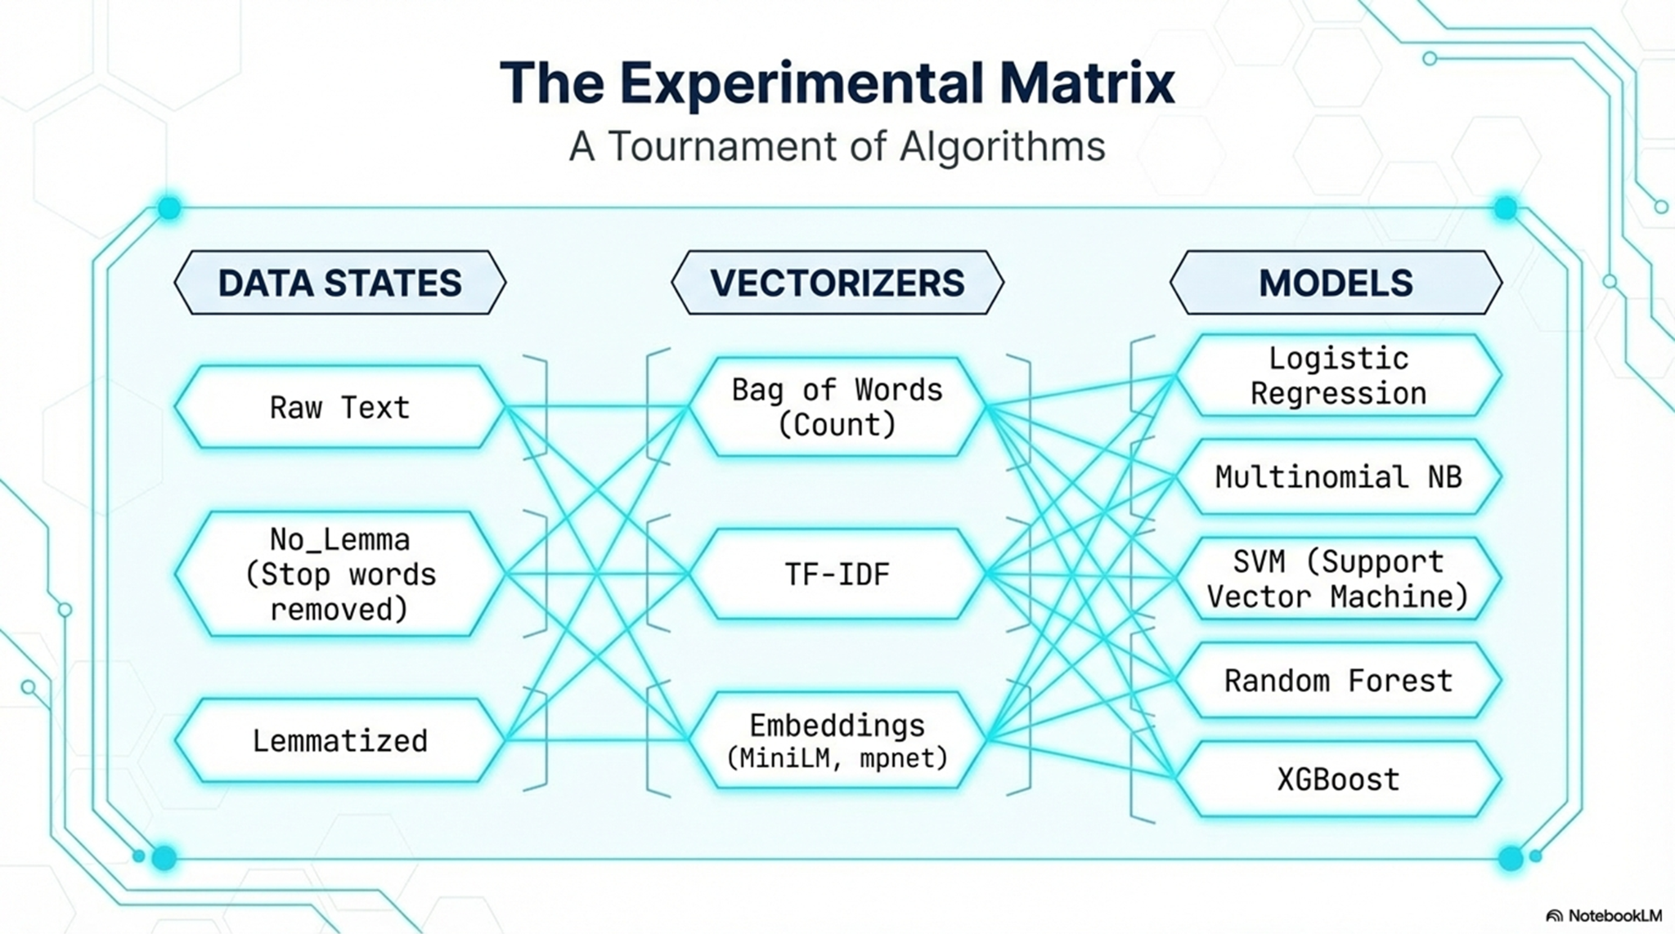

Slide 5
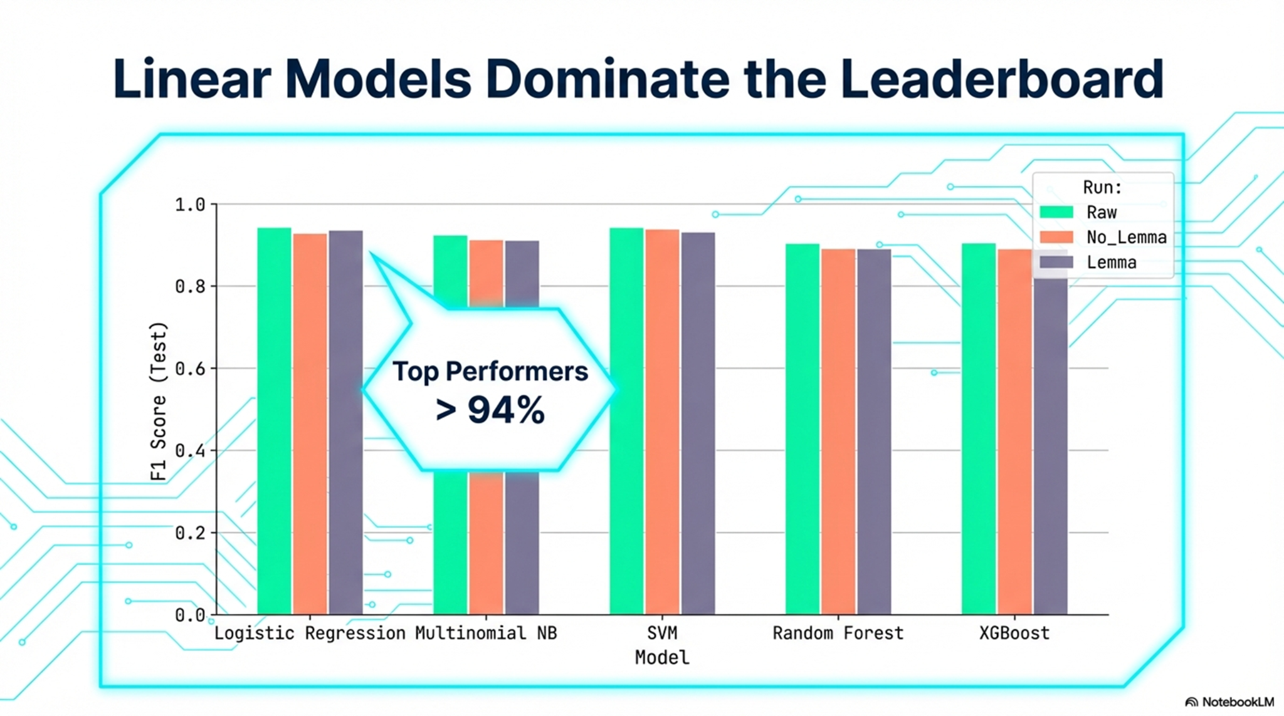

Slide 6
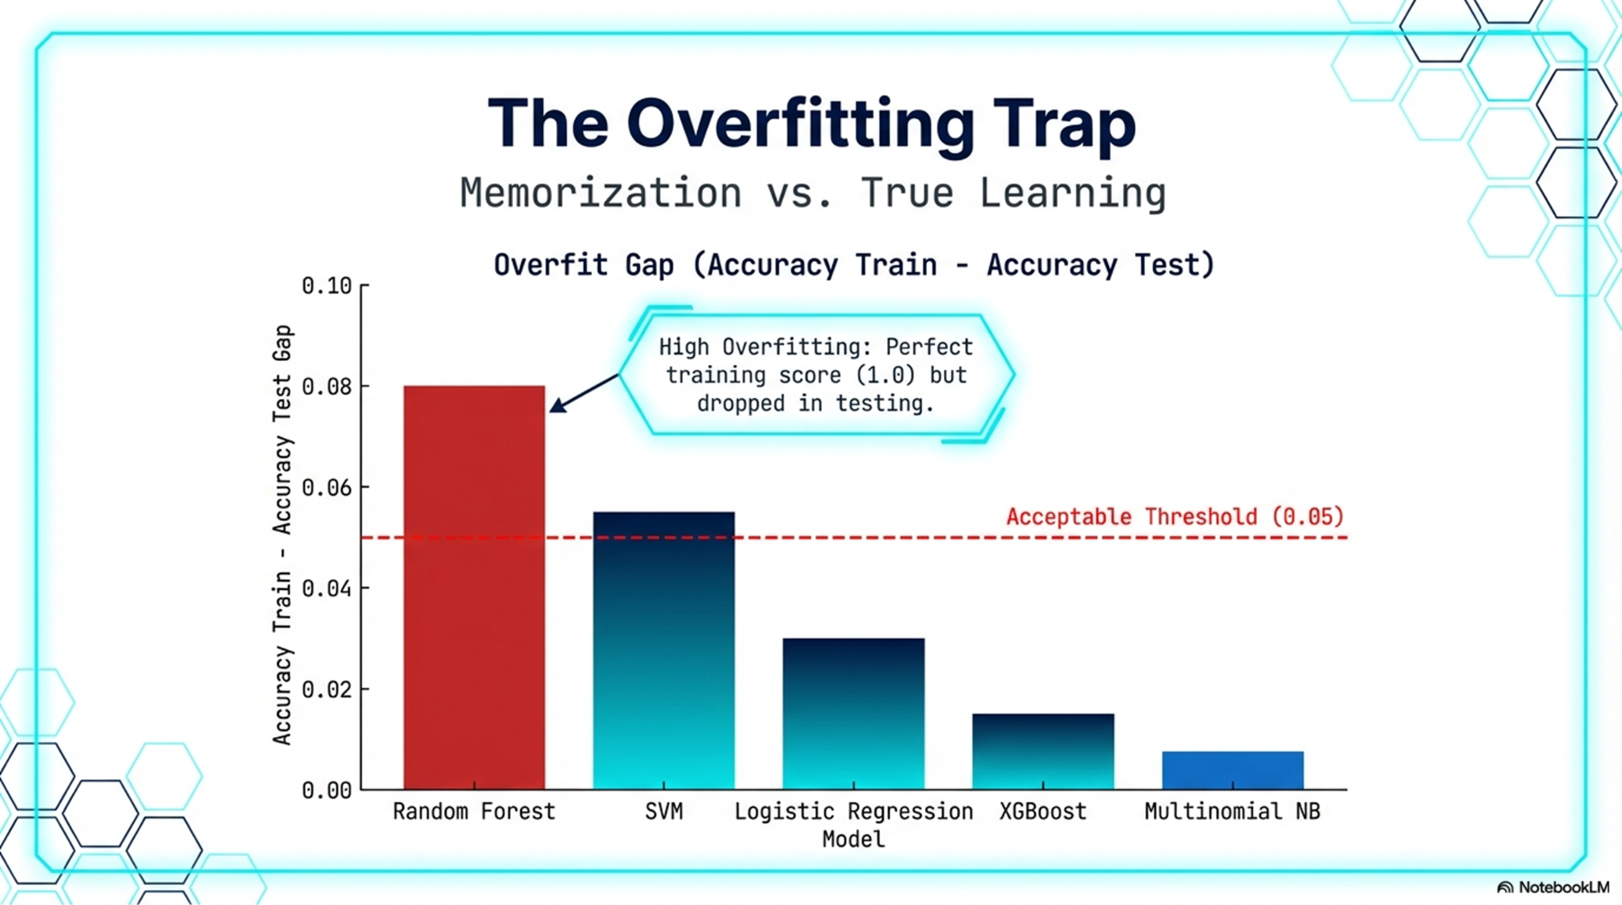

Slide 7
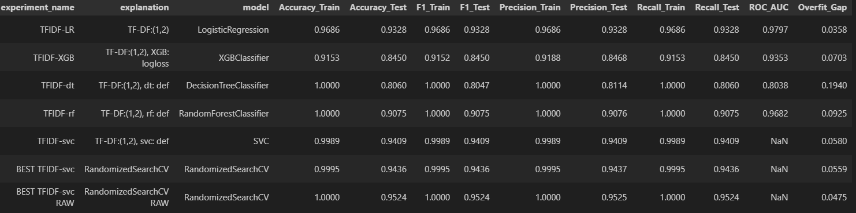
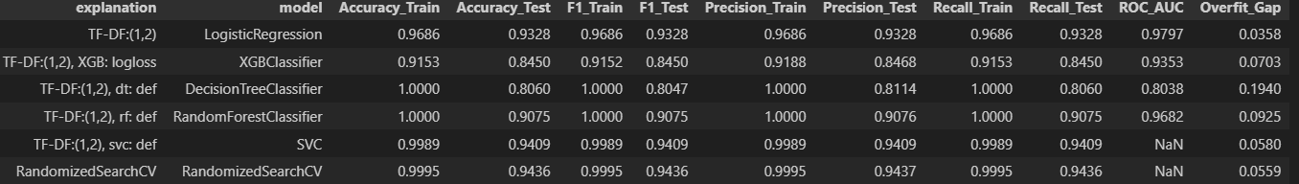
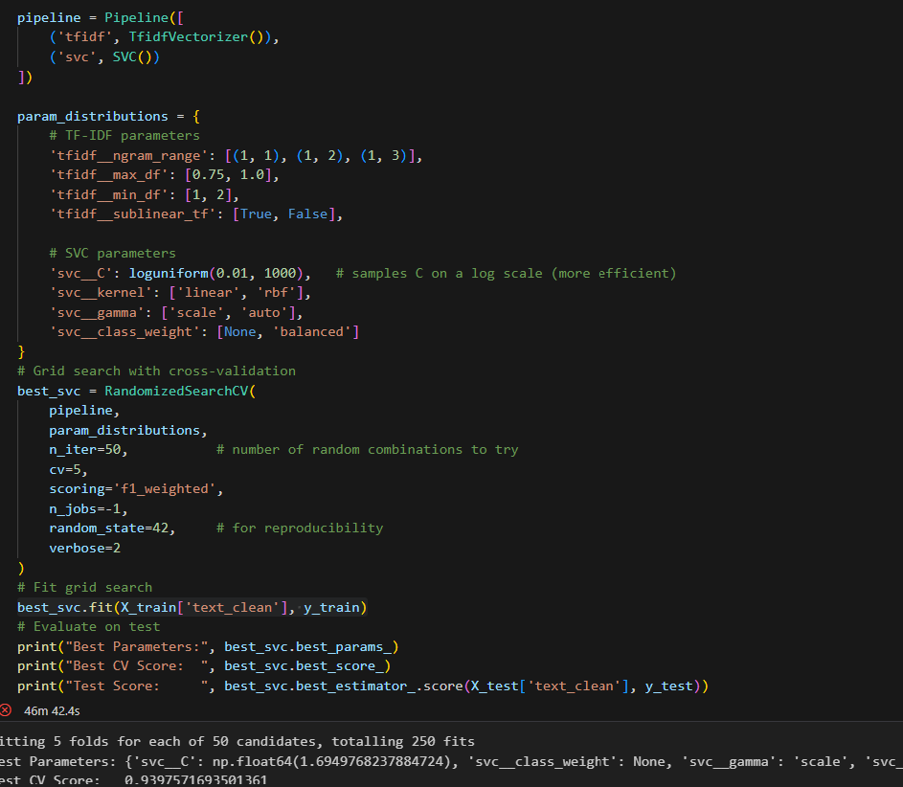
TF-IDF
The ROC_AUC score:
probability that the model ranks a random positive above a random negative, evaluating all decision boundaries rather than just one fixed point

Slide 8
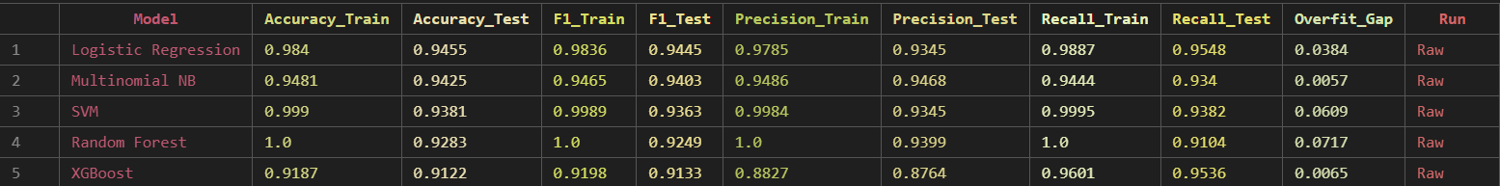
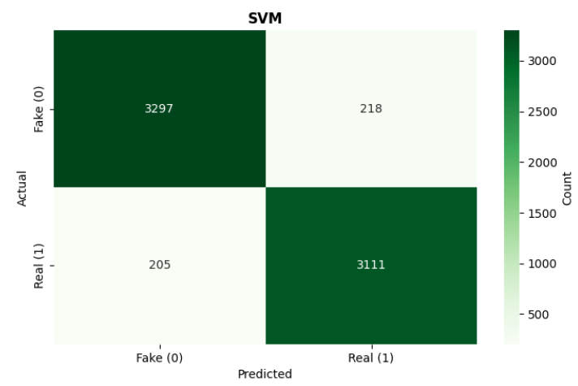
Raw Model: Bow

Slide 9
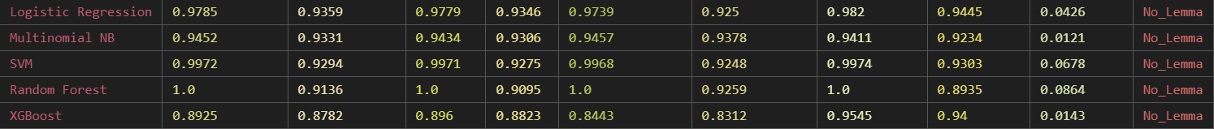
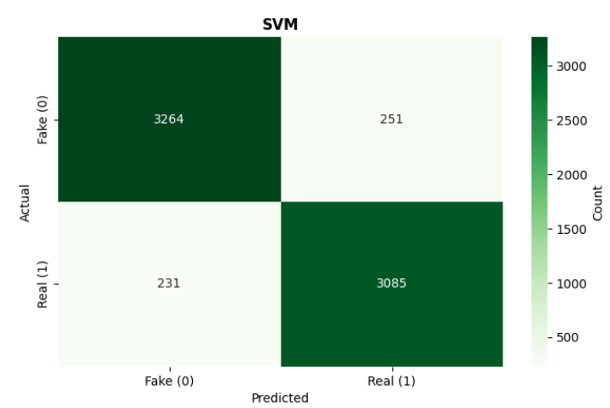
Preprocessed Model: Bow no Lemmanization

Slide 10
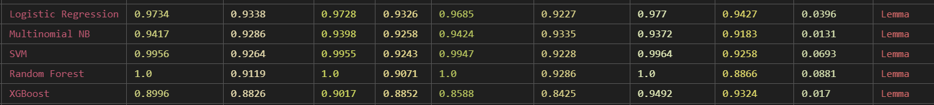
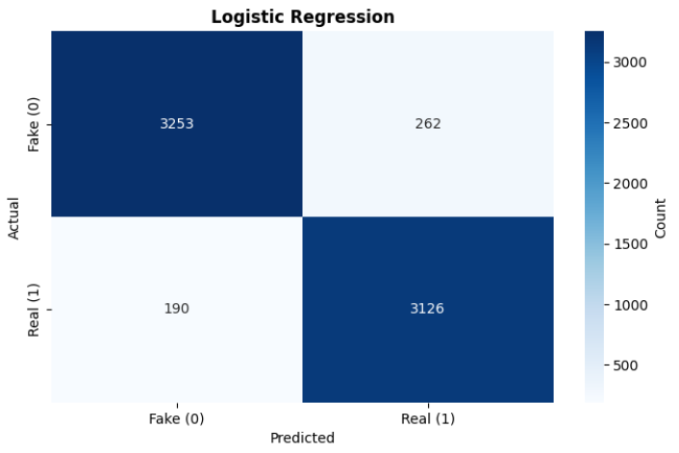
Preprocessed Model: Bow with Lemmanization

Slide 11
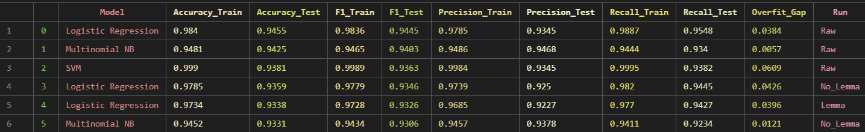
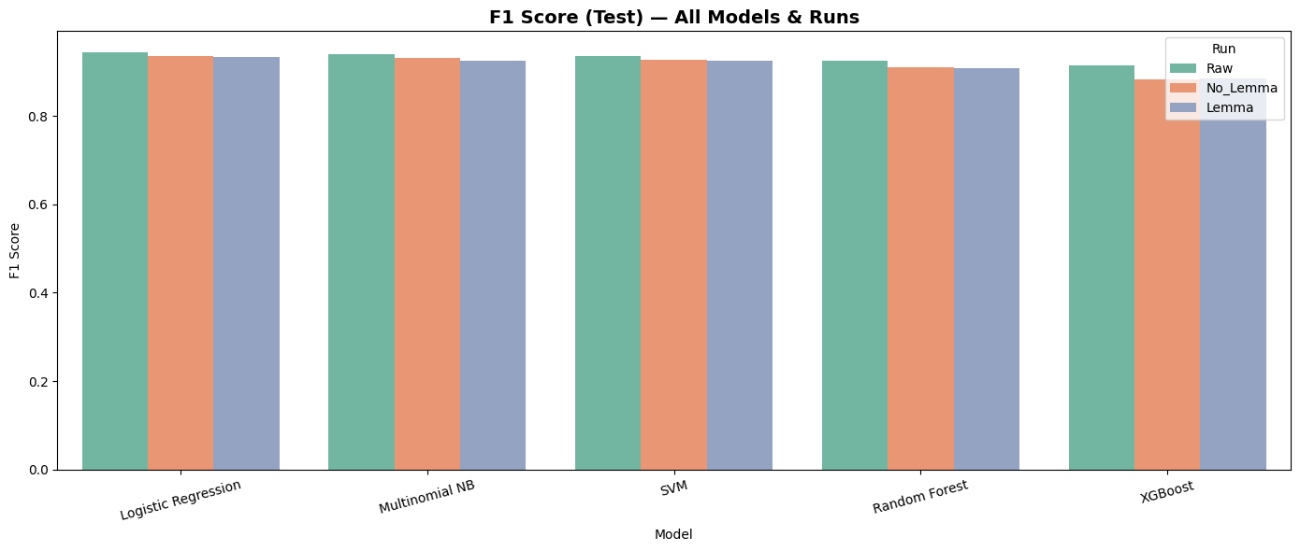
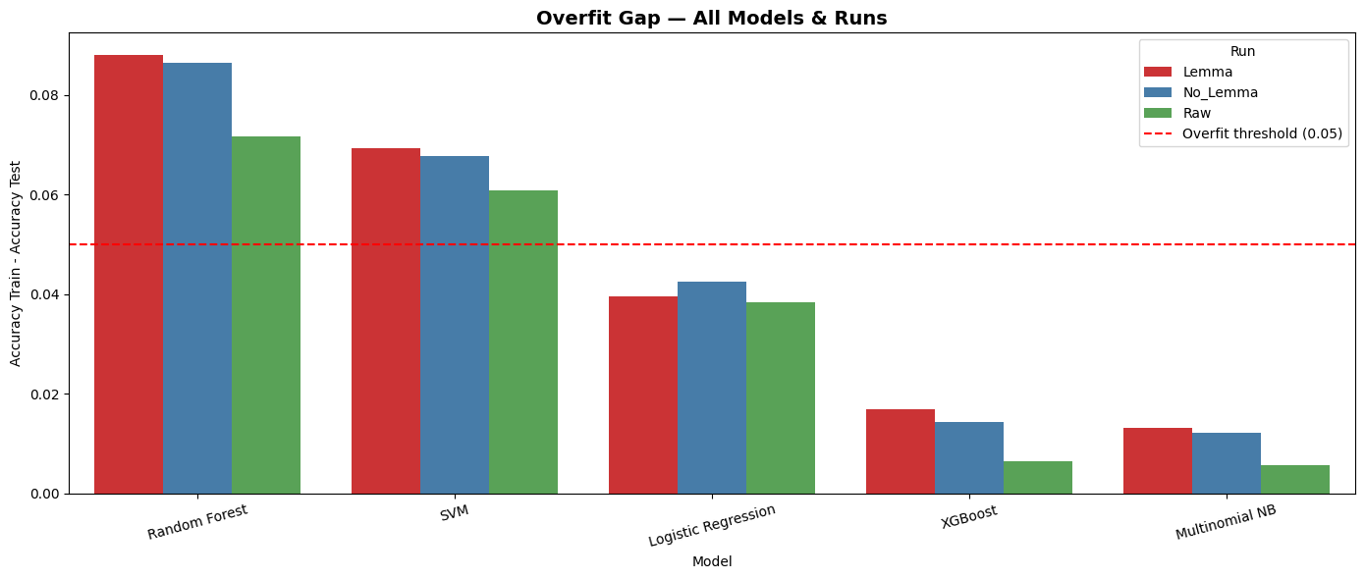
The best model:

Slide 12
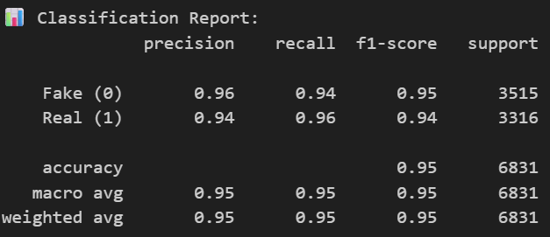
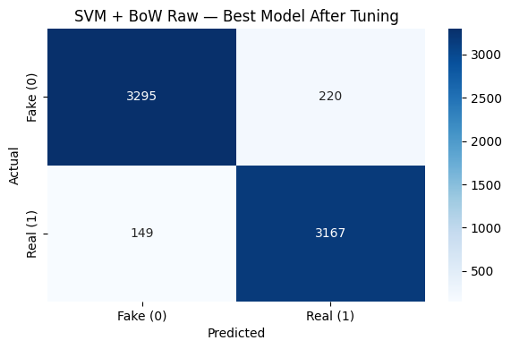
The best model:
GridSearchCV

Slide 13
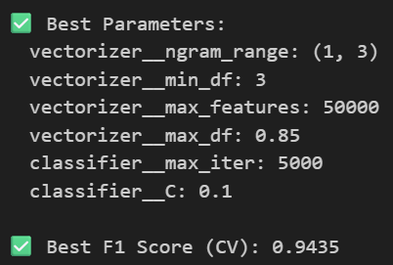

The best model:
GridSearchCV - RandomizedSearch

Slide 14
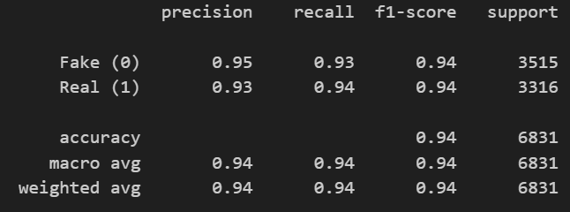
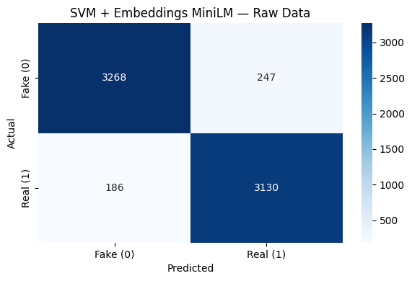
The best model:
Embeddings - small model (384 vectors)

Slide 15
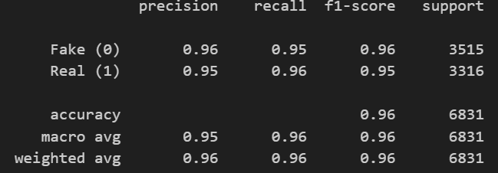

The best model:
Embeddings - bigger model (768 Vectors)

Slide 16


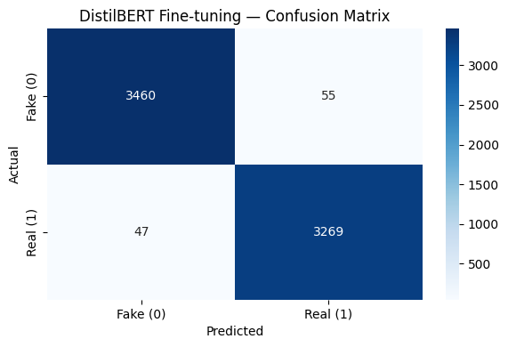
The best model:
Transformers - DistilBert Fine-Tuning

Slide 17


